Slide 1
University Registration System
Made By:
Shamima Islam
ID:151-35-879

Slide 2
About the system
The system is about doing registration of an university where students can request a course catalog containing of course offerings. The system allows students to select four courses. No course will have more than 10 students and fewer than 3 students. After completing the registration process the system sends billing information so the student can be billed for the semester. The university professors must be able to access in the system. They can view their courses and can see which students signed up for their course offerings. And there is a period of time students can change the schedule, drop or add courses.

Slide 3
Register Courses
Module: Student
Register Courses includes:
View Course
Add Course
Drop Course

Slide 4
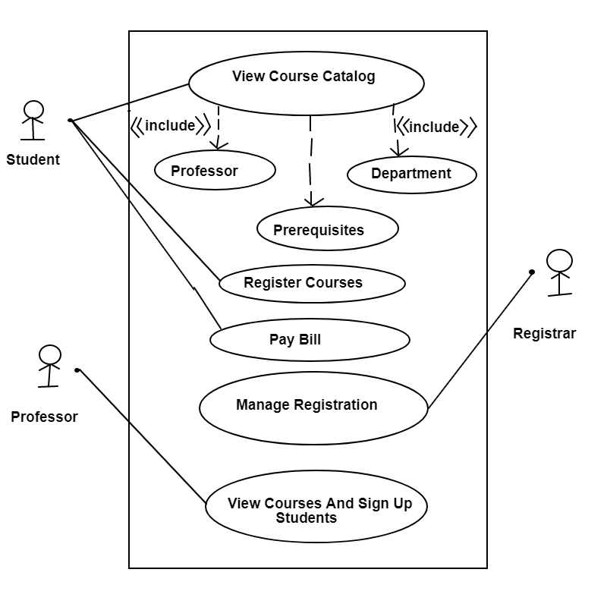
Use Case

Slide 5
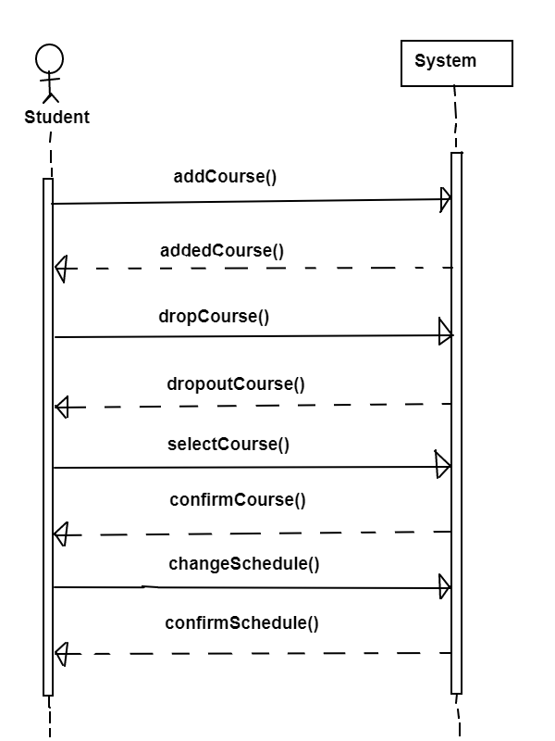
System Sequence Diagram for Register Courses

Slide 6
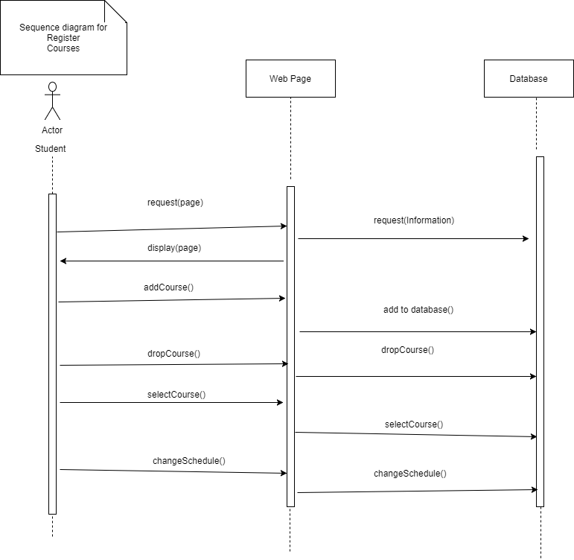
Sequence Diagram For Register Courses

Slide 7
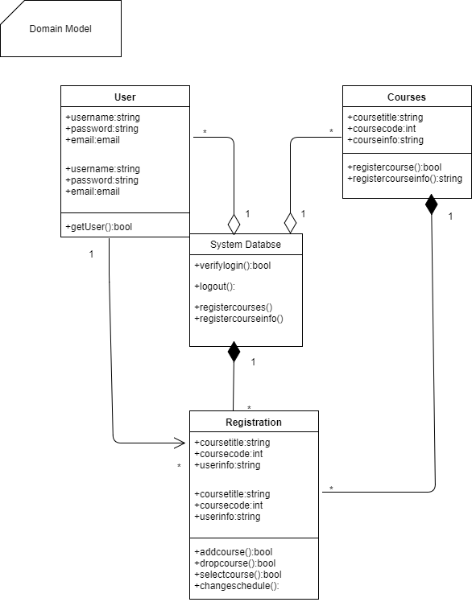
Domain Model

Slide 8

Interface

Slide 9
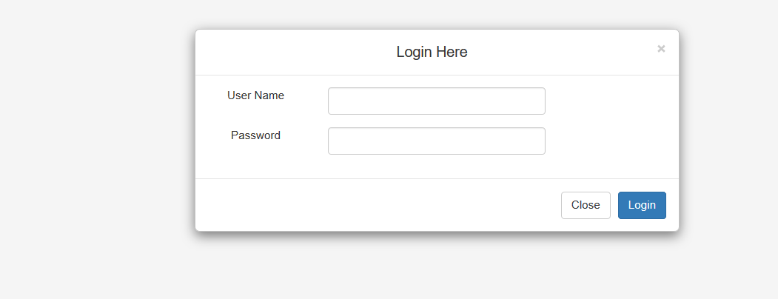
Interface

Slide 10
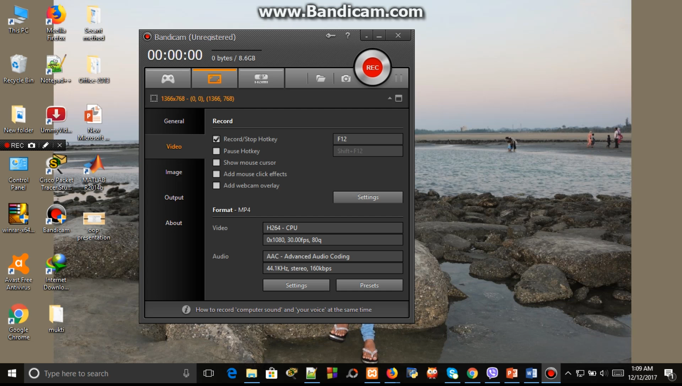
Register Courses

Slide 11
Thank You!!!
For the Patience
☺

